Slide 1
Week 02
HUMAN-COMPUTER
INTERACTION
Usman Institute of Technology
FALL 2022
CS411 Human Computer Interaction
Interaction Design

Slide 2
In the Last Lecture
Usability
Definition
“Ensuring that interactive products are easy to learn, effective to user and enjoyable from the user’s perspective (Preece etal)”
Usability Goals
Effectiveness
Efficiency
Safety
Utility
Learnability
Memorablity

Slide 3
In the Last Lecture
User Experience
Definition
User Experience Goals
Relationship of Usability and User Experience

Slide 4
User Experience Goals
Satisfying
Enjoyable
Fun
Entertaining
Helpful
Motivating
Aesthetically Pleasing
Supportive to Creativity
Rewarding
Emotionally Fullfilling

Slide 5
In the Last Lecture
Relationship of Usability and User Experience

Slide 6
In the Last Lecture
User Experience Goals
Usability
Goals

Slide 7
Fun
Satisfying
Emotionally fullfilling
Efficient to use
enjoyable
Easy to remember
Effective to use
Rewarding
Usability
Goals
Easy to learn
Supportive of creativity
Entertaining
Safe to use
Have good utility
Aesthetically pleasing
helpful
Motivating

Slide 8
Last Lecture’s Revelation
“Don’t Make me THINK, is the key to a usable product”

Slide 9
In Today’s Lecture
Interaction Design

Slide 10


Slide 11

HCI VS Human Factors

Slide 12
What is Interaction Design
Interaction Design (IxD) is the design of interactive products and services in which a designer’s focus goes beyond the item in development to include the way users will interact with it.
Close scrutiny of users’ needs, limitations and contexts, etc. empowers designers to customize output to suit precise demands.
Reference: https://www.interaction-design.org/literature/topics/interaction-design

Slide 13

What is Interaction Design
Reference: https://www.interaction-design.org/literature/topics/interaction-design

Slide 14
What is Interaction Design
“Interaction Design is the creation of a dialogue between a person and a product, system, or service. This dialogue is both physical and emotional in nature and is manifested in the interplay between form, function, and technology as experienced over time.” - John Kolko, Author of Thoughts on Interaction Design (2011)
Reference: https://www.interaction-design.org/literature/topics/interaction-design

Slide 15
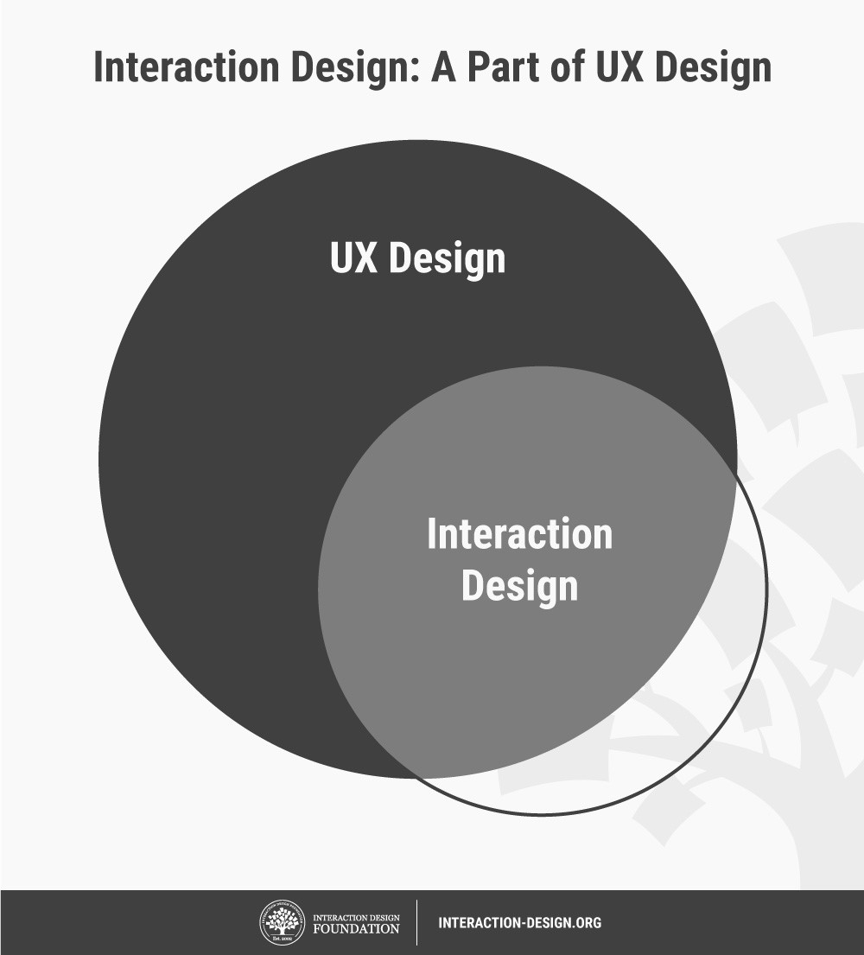
Interaction Design is a Part of User Experience Design
Reference: https://www.interaction-design.org/literature/topics/interaction-design

Slide 16
What is Interaction Design
Designers’ work in IxD involves five dimensions:
words (1D),
visual representations (2D),
physical objects/space (3D),
time (4D), and
behavior (5D).
Reference: https://www.interaction-design.org/literature/topics/interaction-design

Slide 17
What is Interaction Design
Designers’ work in IxD involves five dimensions:
words (1D),
Words (1D) encompass text, such as button labels, which help give users the right amount of information.
visual representations (2D),
Visual representations (2D) are graphical elements such as images, typography and icons that aid in user interaction.
physical objects/space (3D),
Physical objects/space (3D) refers to the medium through which users interact with the product or service—for instance, a laptop via a mouse, or a mobile phone via fingers.
Reference: https://www.interaction-design.org/literature/topics/interaction-design

Slide 18
What is Interaction Design
Designers’ work in IxD involves five dimensions:
time (4D),
Time (4D) relates to media that changes with time, such as animations, videos and sounds.
behavior (5D).
Behavior (5D) is concerned with how the previous four dimensions define the interactions a product affords—for instance, how users can perform actions on a website, or how users can operate a car. Behavior also refers to how the product reacts to the users’ inputs and provides feedback.
Reference: https://www.interaction-design.org/literature/topics/interaction-design

Slide 19
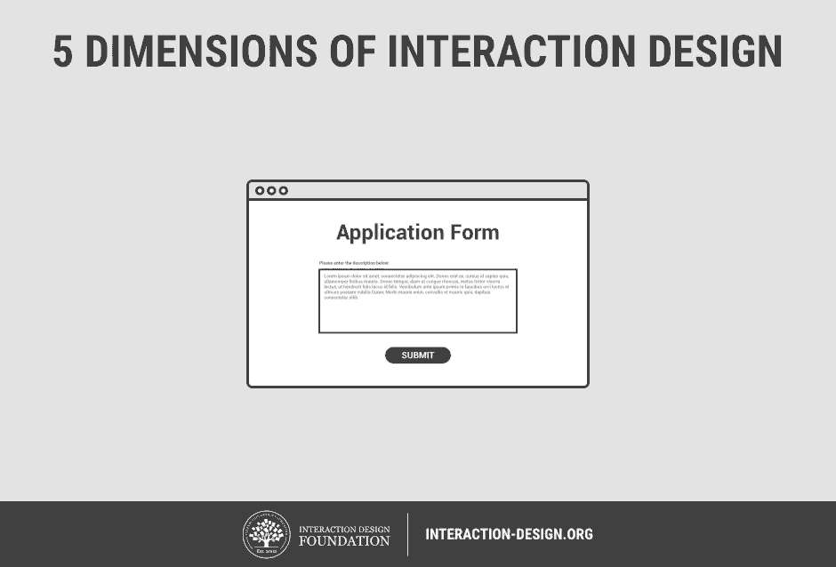
What is Interaction Design
Reference: https://www.interaction-design.org/literature/topics/interaction-design

Slide 20
Questions to Consider when Designing for Interaction
Reference: https://www.interaction-design.org/literature/topics/interaction-design

Slide 21
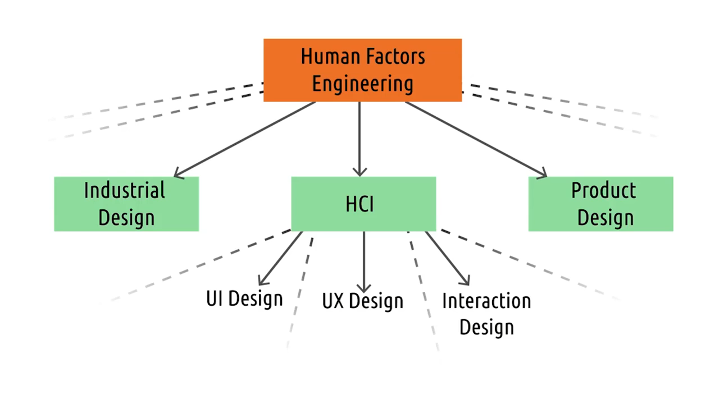

Slide 22
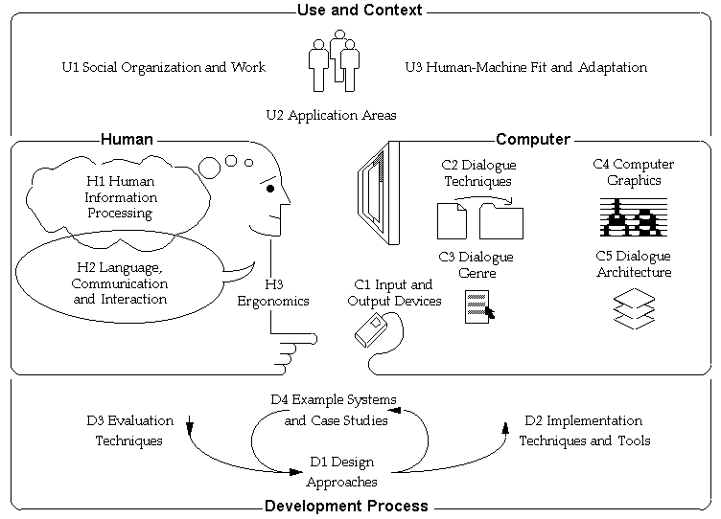
Discipline of HCI

Slide 23


Slide 24
What We Learnt Today …
Factors in HCI

Slide 25
Next Lecture
Interaction Framework

